Slide 1



Agenda
Part one
Outstanding Characteristics - Robert
Part two
An IT Veteran Equals To? – Chenggang
Part three
Let's do a comparison – Zewen

Slide 2



An IT Veteran Equals To
The ability to improve the system, and save uncountable money on things like hardware, development and support.

Slide 3

An IT Veteran Equals To
A pair of foresight eyes that help you find outstanding fresh graduates.
You think you just have one? Actually you have all.

Slide 4
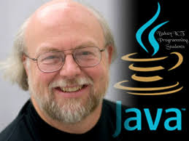
An IT Veteran Equals To
A great teacher

Slide 5

In Summary
So for long term, not only big companies, but also start-up companies especially, are really supposed to hire an IT veterans firstly, to lead the team, to grab the chance and win all kinds of battles in the market competitions, and finally make huge success.

Slide 6


